Slide 1


Mobile Application Presentation and Business Proposal

Slide 2
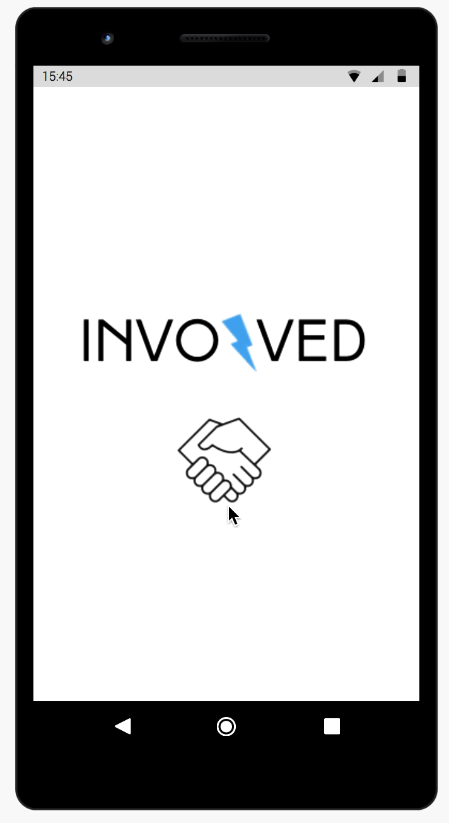
App Interface
Part 1

Slide 3
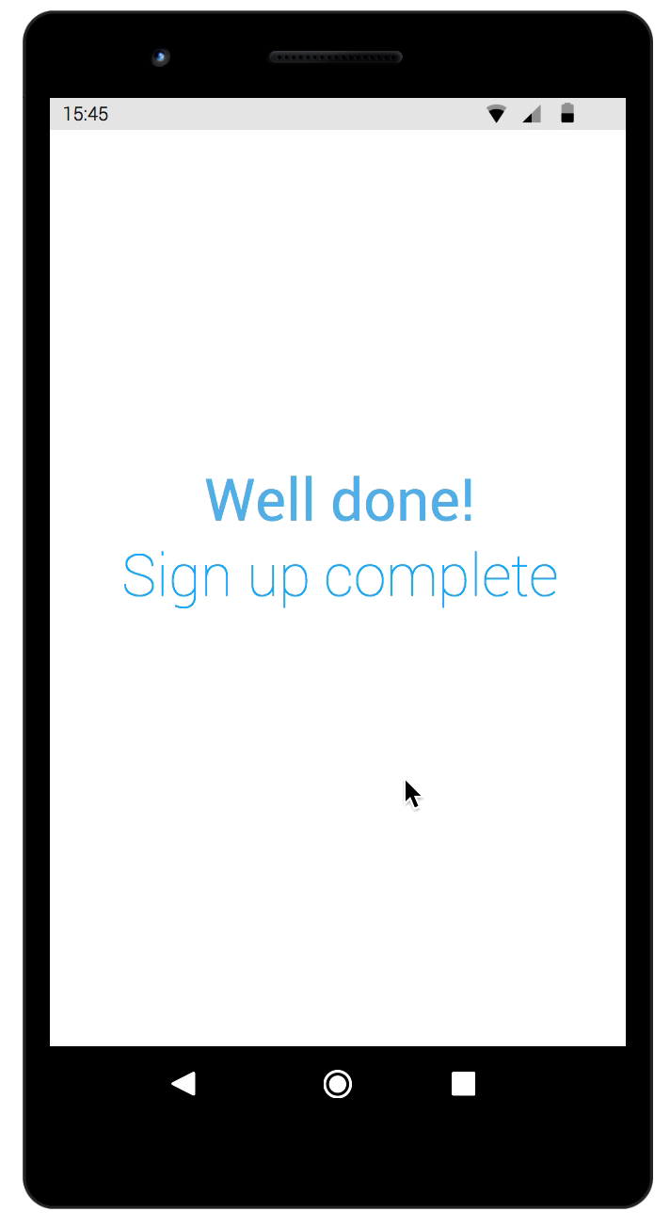
App Interface
Part 2

Slide 4
About us:
Business Model
The application will operate as a multi-sided platform, providing network benefits to the two sides of our customer base. One side encompasses companies, organizations and institutions of all sizes wanting to promote initiatives and organize activities to further transform communities into more sustainable environments for future generations. While this is happening, the other side will consist of ambitious individuals; users who want to contribute to community and want to connect with an organization that shares the same passion for change as they do.
The platform will provide users with a reward system to update their profile status every time they take on an activity or participate in an event. After collecting a significant amount of points and reaching achievement milestones, individuals will be given participation honor certificates, that can be completely shareable through other platforms for everyone to share their work and motivate others to do the same.
The app will provide its services for free to the most price sensitive side ( end-users), while companies and organizations will have to pay a monthly fee for having access to the platforms network.

Slide 5
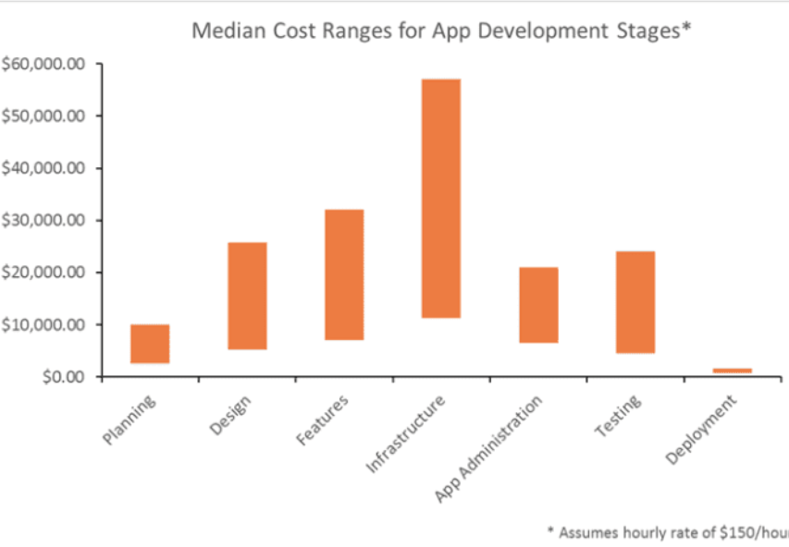
Medium Range Complexity App for Android
App Features
Projected Cost Graph
Completely customized UI features
Accepts payments
Has API integration
Adaptable for headsets, tablets and computers
Back – end server
Cost roughly around 47,000 – 80,000 $

Slide 6

Mobile App Architecture
Client – Server, Layers and Tiers

Slide 7
Clean Architecture
It is critical to build the app with principles of Clean Architecture from the beginning. Although it is not technically necessary, it will make the scaling and complexity much easier to handle down the road.
What?
Software design principles that keep design elements separate.
Why?
As elements are kept separate, it is easier to make changes in the long run whilst minimizing possibilities of bugs and major outages.
How?
By keeping the business logic code layer unalterable by other layers, it remains the same even when other layers such as interface, gateways, and API’S change

Slide 8
Layers
Representing our app’s architecture are the 3 layers that make up all successful applications that seek to harvest and utilize data for maintaining a robust platform that users and businesses alike can trust with their information
Presentation
Clean and concise
Prompt style progression
High but pleasant contrast
Business
Focus on gaining user and company preferences
App will pull from cached data stored in databases to make suggestions and improve UX
Clicks and page visit length tracked
Data
Consistent use of API’s linking users to company websites – Persistence & Consistency
Reliable connection to network services and data hosting/storage
Cached data to make recommendations for users and companies

Slide 9

Big Data & Digital Business Strategy
Insights to our Big Data Management Policies

Slide 10
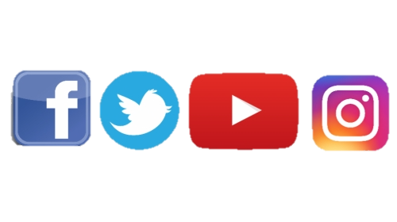
Data Collection
For market research purposes, collecting data from our customer’s behavior can help us identify market frictions where we can deploy our services, while at the same time target customer preferences by building unique features.
Prior to Launch
Post Launch
Data sources → Instagram, Facebook, Twitter and phone calls
For Marketing research → Primary data
(expensive to obtain, but insights are statistically significant)
Data sources → Mainly by monitoring on-site traffic, subscriptions, and registration data.
Consent policy that will allow App developers to access customer data on their on-site behavior

Slide 11
Data Integration
The main problem that all apps are facing is that they must deal with a lot of raw data in an unstructured form. 80% of collected data is projected to be categorized as unstructured.
Logs → Application logs stored as page visits, button clicks and logins
Part of them can be structured to contain dates, log types and URLs
The only way to manage is through UDFs, custom code written in Hive or Pig
Hadoop software framework can be used to process and integrate this kind of data
Fully Unstructured Data → Data collected from social network statuses, emails, documents, images and videos (as free text or bits + bytes)
Extracting structure from this data needs the use of advanced algorithms

Slide 12
Data Handling
Data needs to be stored and handled in a way that will allow to be assessed easily.
Big Data storage can handle very large amounts of data and ensure protection and encryption of cyber-attacks.
Warehouse Storage
Cloud Storage
Large building facilities optimized to retain and process large amounts of data.
Ability to feed them in and out through online servers where users can access their data without delay.
Ability to translate raw data into information and insight.
More expensive, consumes more power, space and has higher operation risk.
Data and information are stored electronically online.
Data can be accessed from anywhere, no need for direct attached access to hard drives
Cloud storage is significantly cheaper than physical storage of data

Slide 13
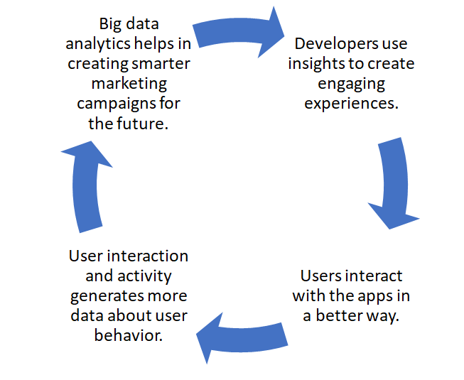
Data Analysis
The role of Big Data in mobile app development is not only for assessing the data and providing insights, but it runs more intensely.
WBS
Improve Operation Performances
Analysis of User – Experience (User engagement)
Customized Marketing Strategy
Sales Conversions (Updates)
IoT devices
Machine Learning
Real-Time Data Management
IoT and Cloud Tech (scale)
Data collection for advertising purposes
Create a loyalty program
KPIs ( AMOG, D1/D7/D30 Retention, Target MAUs, IAPs)

Slide 14
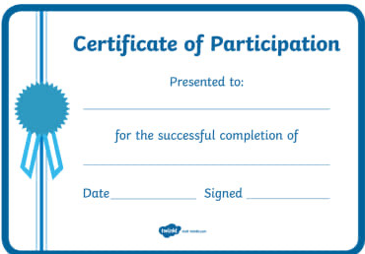
Point Reward System
Certificate of Completion
Data collection to further create a loyalty program to increase customer retention to reduce costs and achieve business growth
Point reward system → increase engagement
Users will also be rewarded for participating in feedback activities and for sharing their opinion

Slide 15




Thank you!
Vasilis Philippou
Sofiana Theocari
Mira Debs
Nicholas AI-Rehany

